Slide 1


Opening Doors

Slide 2


Meet Nazarii
Nazarii’s story

Slide 3
Our aims
Provide refugees with autonomy over their livelihoods while transitioning into a new society
Connect the diaspora to resources and opportunities to accelerate the burdensome bureaucratic system
Encourage open and honest communication within the job finding sphere and within refugee communities

Slide 4
How we can help millions of people like Nazarii
Vicious cycle
Automation
Safe access to resources

Slide 5
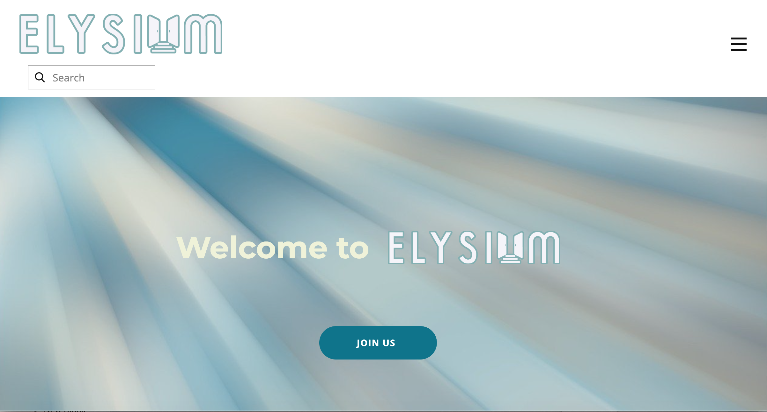
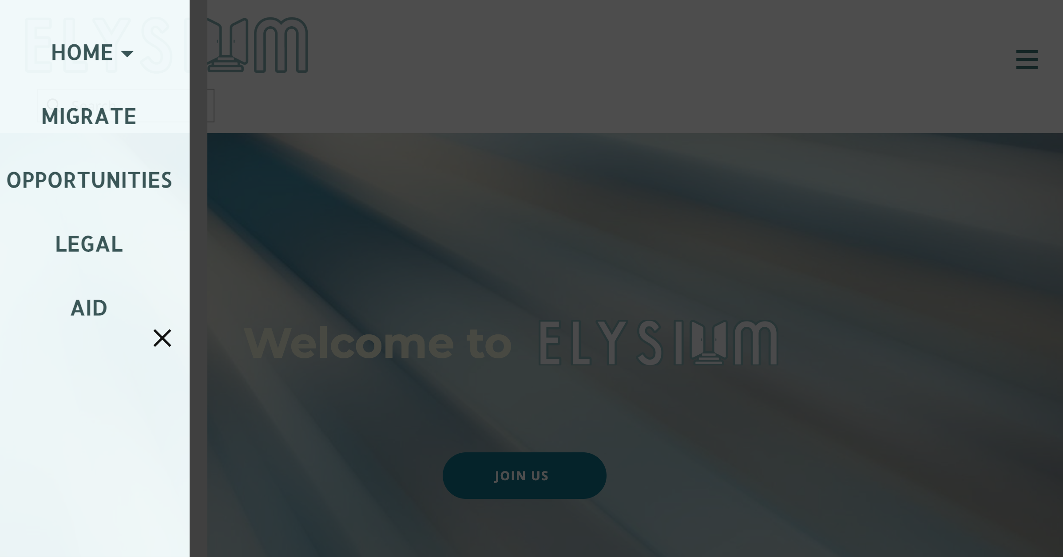
Web platform
Accessibility- public libraries provide access to computers, not phones
Easy to navigate

Slide 6
Features
Access to jobs and opportunities
Access to charities, NGOs and aid
Access to human rights and legal advice
Access to a community of people in the same circumstance, speaking the same language

Slide 7
Community Feature
“myCommunity” connects you with others in the area, with the same background
People in community can help one another with contributions being verified by our platform
Operated as a peer-to-peer network where transactions are verified using distributed ledger technologies

Slide 8
Community feature
User’s skills, as listed on their profile, are able to be harnessed by other members through a hiring/booking system
Once a job is complete, a mutual rating system verifies the quality and completion
ELYSIUM will implement a time-based economy, which viewed by the user operates as a token system

Slide 9
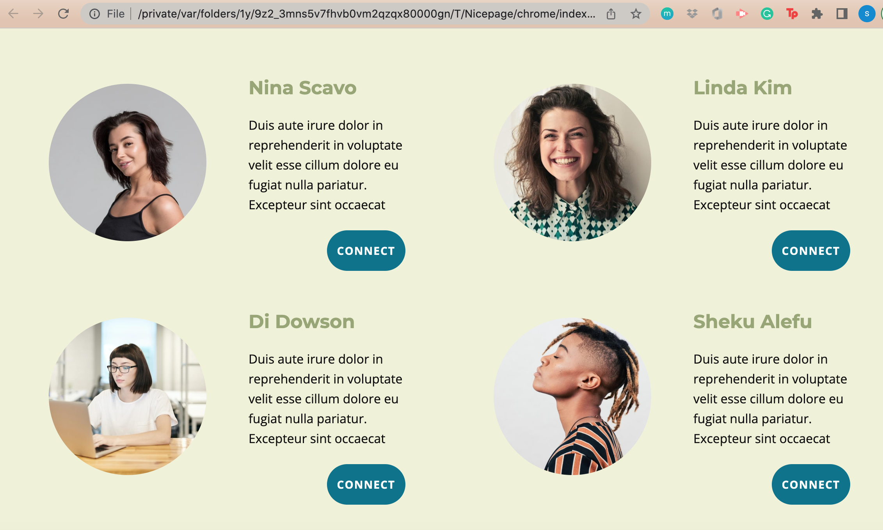
Opportunities Feature
Job listings: with % match to skill
Reccomendation based on matching algorithms. Eg: K-nearest neighbour
Free online courses reccomended
CV builder (add to profile) automatically updates with community corroborated experience
Built in translation

Slide 10
Aid
Connect with charities and NGOs in local area
View location on map segment
Platform will offer charities the option to distribute aid through ELYSIUM using ledger technology to promote fair allocation and minimise corruption
Each user has an ID assigned to a soulbound token

Slide 11
Legal Advice
Users able to view international human rigths in required language
National rights and legal information
Pro-bono legal advice (lawyers verified by ELYSIUM)

Slide 12
Security Risks & Mitigations
Accidental misuse of the platform: thorough testing and simulation running
Verification: n users verify new users
GDPR is considered as personal data is collected
ELYSIUM operates as an NGO discourages data mining for profit
Surveillance : blockchains are public; only necessary information is stored on blockchain
Time-based economy prevents users monopolizing the system

Slide 13
Future feature releases
Language learning facility (provided by a collaboration with a language learning app such as Duolingo)
“Kid’s zone”, for children to access opportunities and resources

